Slide 1


Final Project Summary Topic: Fuel consumption and CO2 emissions from passenger cars: Statistics and Analysis G01388664 Pravallika Avula

Slide 2
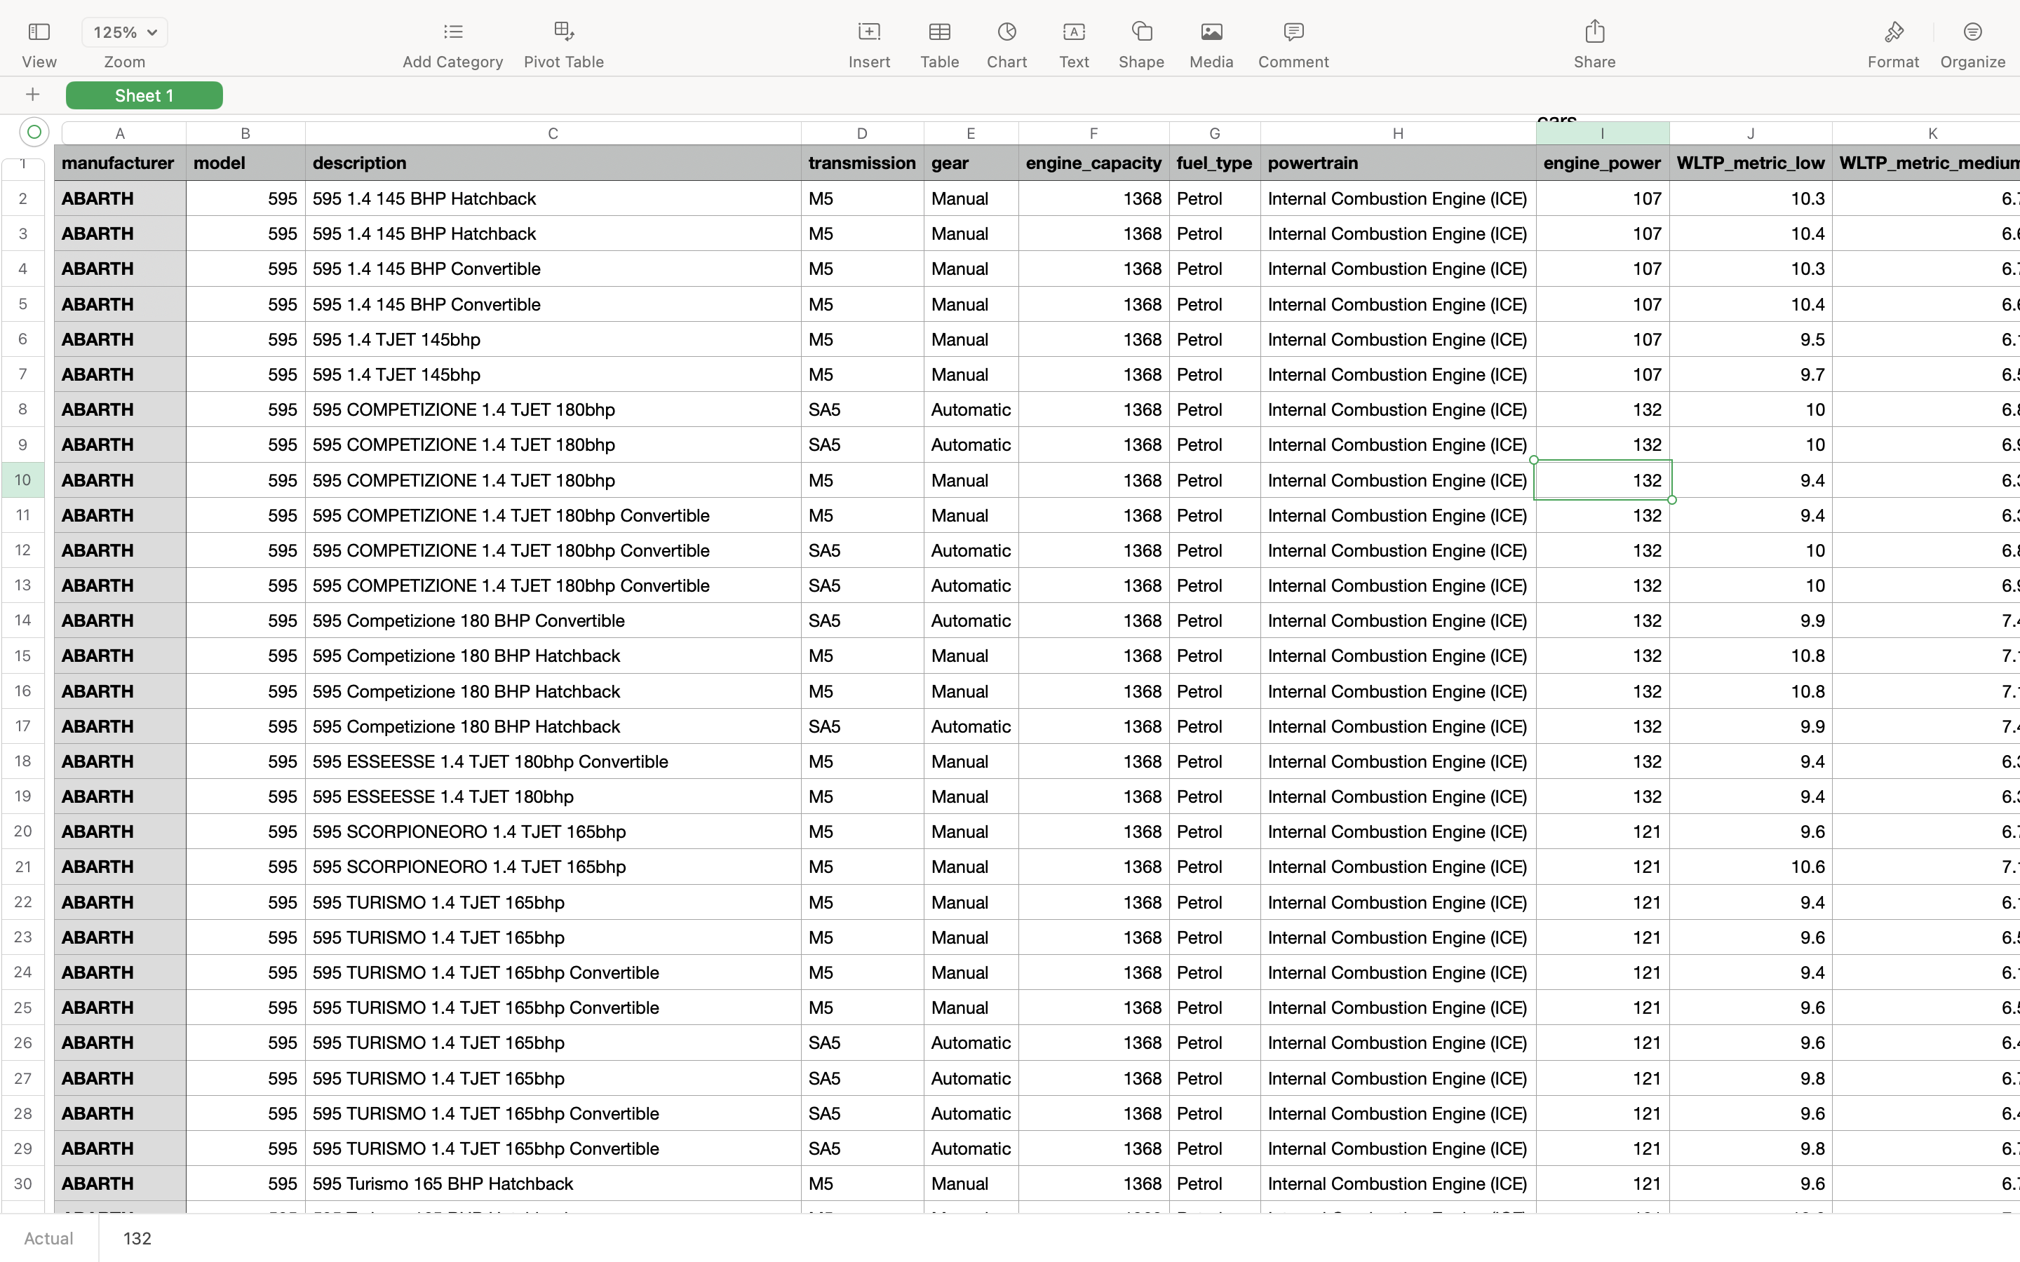
DATA SET DESCRIPTION
The selected dataset contains the fuel consumption and emissions details for a new or used car from 2000-2013 in UK.
By studying this dataset one can create awareness about the car specifications that should be considered to release less carbon dioxide. I have chosen this dataset to study the pattern of fuel consumption in different areas and different pollutant gases.
Dataset source: https://carfueldata.vehicle-certification-agency.gov.uk/downloads/download.aspx?rg=latest
METHODS
I used Python to clean and transform the data. I also made few visualizations using python to plot graphs for research questions 1&3
Rstudio has been used for visualizations and interpretations.
I also used SQL for loading data and running queries.
RESEARCH QUESTIONS
Which car manufacturer produces the most air pollution and noise pollution?
Which car model produces the most air pollution and noise pollution?
How are fuel costs and emissions related?
What are the characteristics of the car with low emissions?

Slide 3
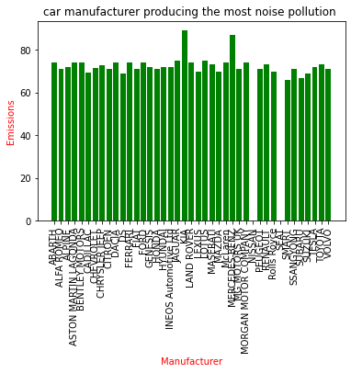
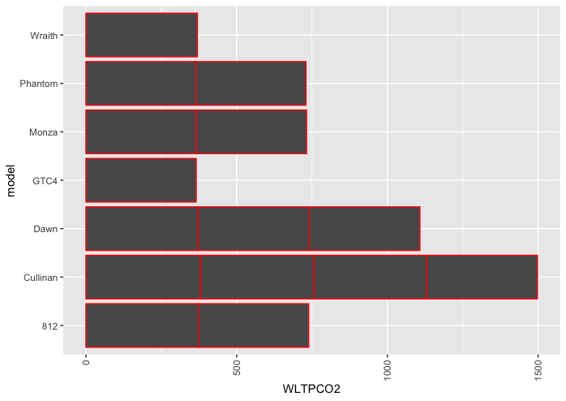
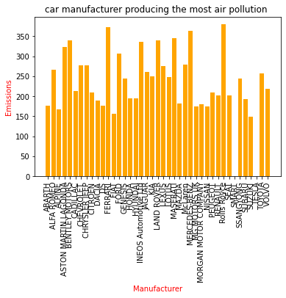
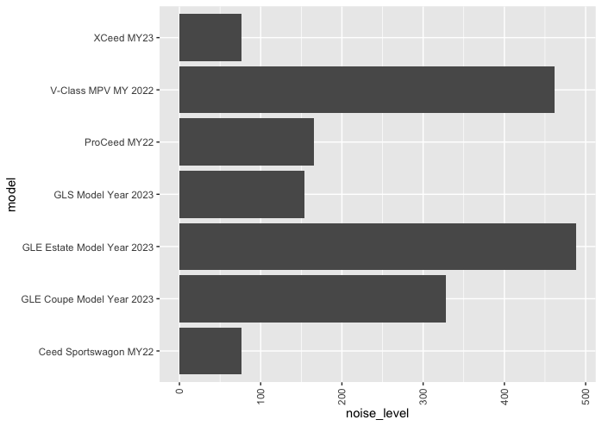
1) car manufacturer producing the most air pollution and noise pollution
2) car model producing the most air pollution and noise pollution

Slide 4
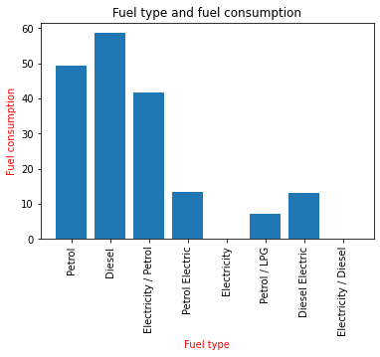
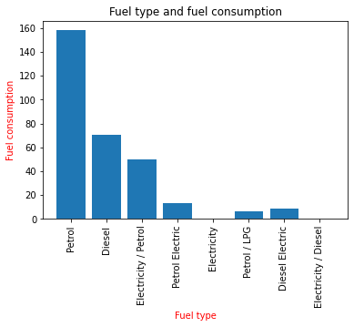
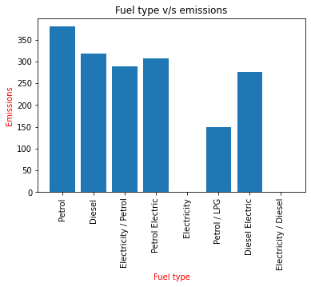
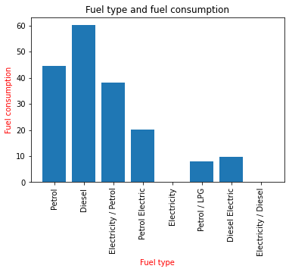
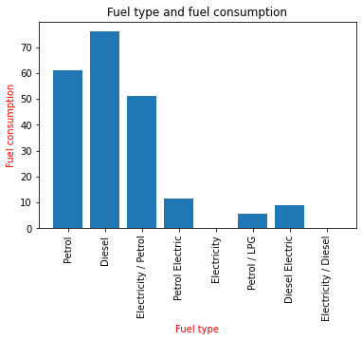
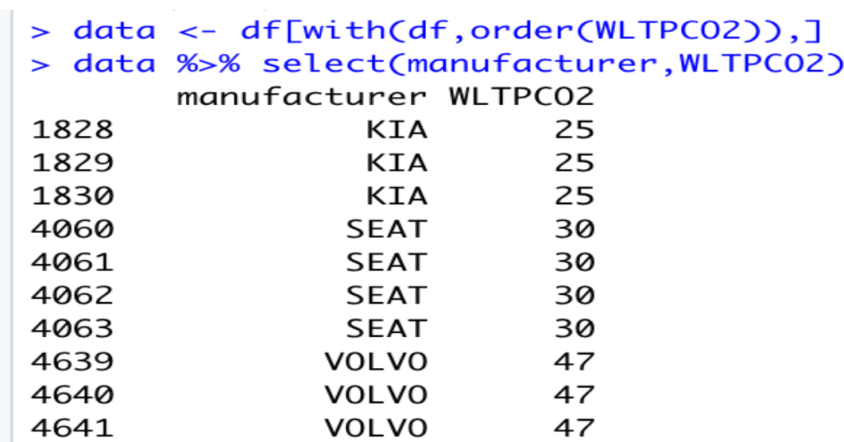
3) Fuel costs and emissions relationship
Fuel type v/s WLTP Metric Low
Fuel type v/s WLTP Metric Medium
Fuel type v/s CO2 Emissions
4) characteristics of the car with low emissions
‘Sportage MY22’ model, Kia manufacturer “'GT-Line' 1.6 T-GDI 261 bhp PHEV” is the description,
‘AT6’ transmission, ‘Automatic’ gear, with ‘1598’ engine capacity,
‘Electricity/Petrol’ fuel type, ‘Plug-in Hybrid Electric Vehicle (PHEV)’ power train
are the characteristics that a car should have for to release less emissions.
Fuel type v/s WLTP Metric High
Fuel type v/s WLTP Metric Extra High

Slide 5
LIMITATIONS
I have faced many limitations while performing research. Firstly, the dataset is large and and consisted of errors. As the dataset is large cleaning the data was difficult. Secondly, different software’s gave different outputs. I had to create and sort tables to compare the visualizations for the right answer.
In the 4 research questions, I didn’t consider the noise pollution. Kia manufacturer has low carbon emissions but more noise pollution. Hence, one must conduct more research and analysis to determine the optimal car characteristics if they want to reduce the noise levels too.
FINDINGS
From the visualizations we can tell that ‘Rolls Royce’ and ‘Kia’ manufacturer is causing more pollution hence he should consider the factors that are leading to the more emissions and try to avoid them.
From the visualizations and interpretations, we can tell that ‘Cullinan’ ab ‘GLE Estate model year 2023’ models are causing more air and noise pollution. Proper measures can be taken for the models by trying to change the design or engine.
Diesel is the most common fuel used in many areas including rural areas. Hence, diesel is contributing to the most of carbon emissions. Although Diesel is mostly used, Petrol causes more pollution. LPG, Electricity led to less emissions. Hence, public must be made aware of this information and government measures must be taken to use the fuels that create less pollution.
The characteristics, a car must have so that it produces less emissions are ‘Kia’ is the manufacturer. ‘Sportage MY22’ model has the lowest emissions, “'GT-Line' 1.6 T-GDI 261 bhp PHEV” is the description, ‘AT6’ transmission, ‘Automatic’ gear, with ‘1598’ engine capacity, ‘Electricity/Petrol’ fuel type, ‘Plug-in Hybrid Electric Vehicle (PHEV)’ power train are the characteristics that a car should have for to release less emissions.

